Slide 1

Loudoun County Growth Study
By: Andrew Kemp

Slide 2
Purpose of the Study
Examine Loudoun County's economy: employment, business growth, income, housing costs, and GDP.
Benchmark against Fairfax (VA), Montgomery (MD), Santa Clara (CA), Dallas (TX), Davidson (TN), and Wake (NC).
Recommend strategies to sustain growth and attract projects.

Slide 3
Methodology
Data Sources: U.S. Census Bureau, Bureau of Labor Statistics (BLS), Bureau of Economic Analysis (BEA)
Tools and Techniques: Jupyter Notebook, Python, Pandas, NumPy, Matplotlib, Seaborn, Scikit-learn, Statsmodels.
Analysis Techniques: Descriptive statistics, Trend Analysis, Comparative Analysis, Time-series, linear regression, correlation analysis, ARIMA forecasting,

Slide 4
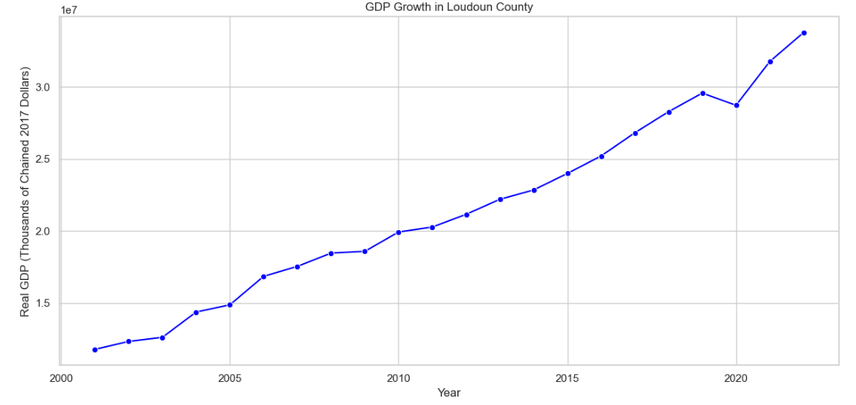
GDP Growth in Loudoun County (2000-2023)
GDP grew 186% from $11.78B (2001) to $33.77B (2023).
2020 dip highlights COVID-19's economic impact and vulnerabilities.
Growth driven by high-value industries and economic expansion.

Slide 5
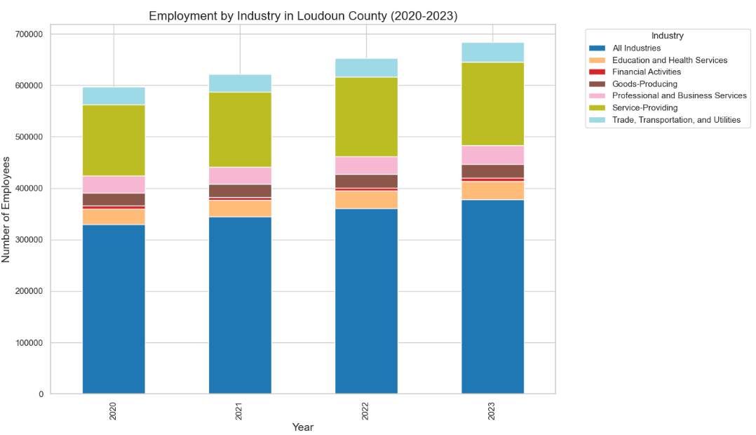
Employment by Industry (2020-2023)
Service-Providing Industries dominate, led by Education, Health, and Professional Services.
Steady employment growth highlights post-pandemic recovery.
Trade and Utilities remain stable, ensuring economic support.

Slide 6
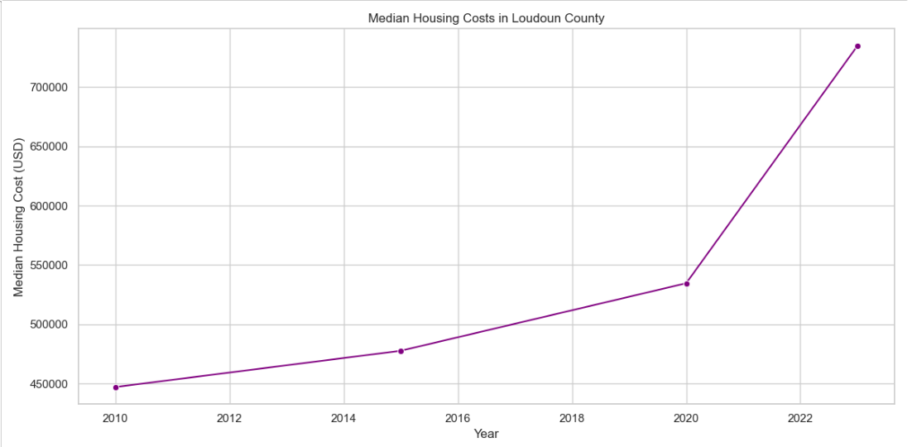
Median Housing Costs in Loudoun County (2010-2023)
Median housing costs increased 64.3%, from $447,100 (2010) to $734,700 (2023).
Post-2020 surge due to population growth and limited supply.
Rising costs challenge affordability for middle-income families.

Slide 7
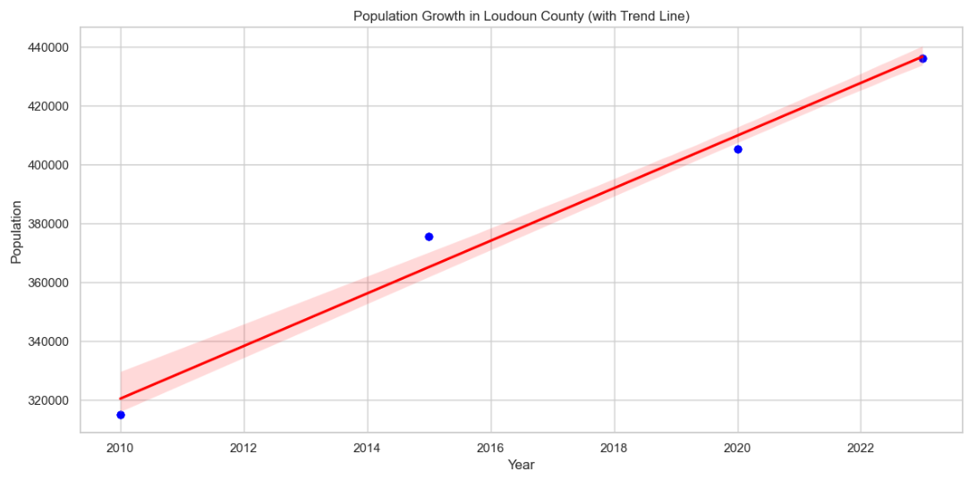
Population Growth in Loudoun County (2010-2023)
Population grew 35%, from 322,000 (2010) to 435,000 (2023).
Steady growth reflects economic opportunities and high quality of life.
Increasing population may heighten demand for housing, infrastructure, and services.

Slide 8
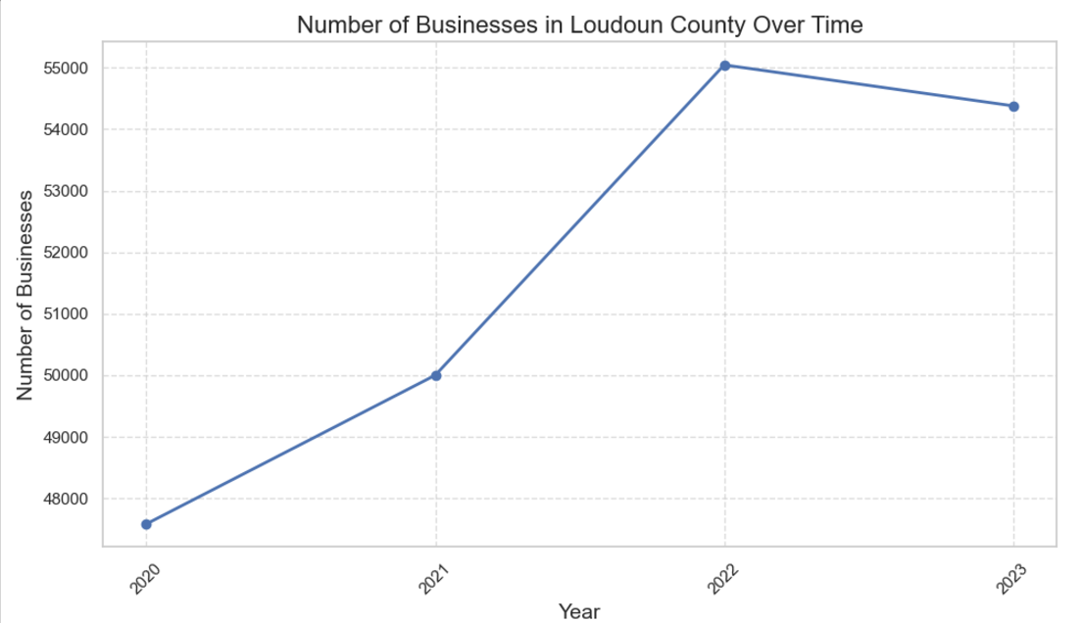
Number of Businesses in Loudoun County Over Time (2020-2023)
Steady growth (2020-2022): Business numbers rose, showcasing economic resilience.
2023 decline: Business numbers dropped, highlighting post-pandemic challenges.
Policy need: Focus on business recovery and ensuring long-term stability.

Slide 9
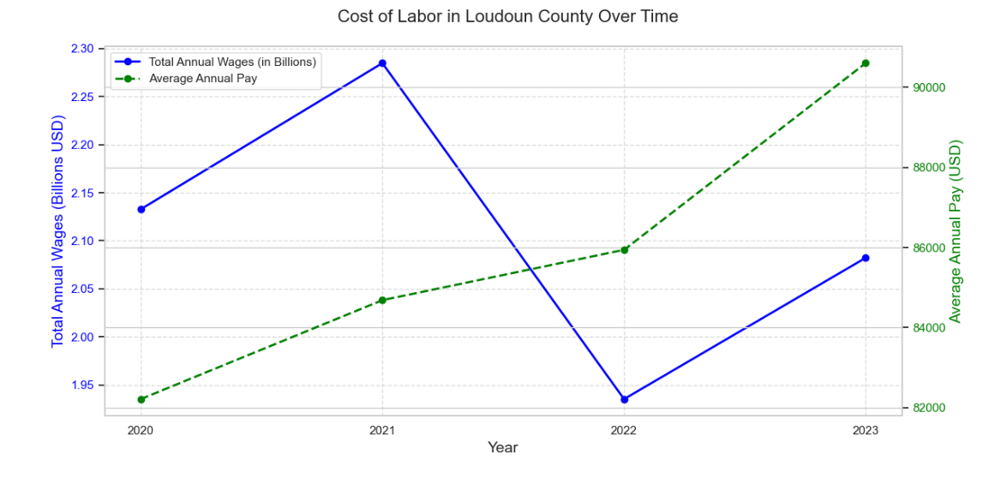
Cost of Labor in Loudoun County (2020-2023)
Wages peaked in 2021: Total annual wages hit $2.3 billion, followed by a sharp drop in 2022, recovering by 2023.
Pay increased: Average pay rose steadily from $85K (2020) to $90K+ (2023).
Implications: Divergence signals workforce reductions or employment shifts.

Slide 10
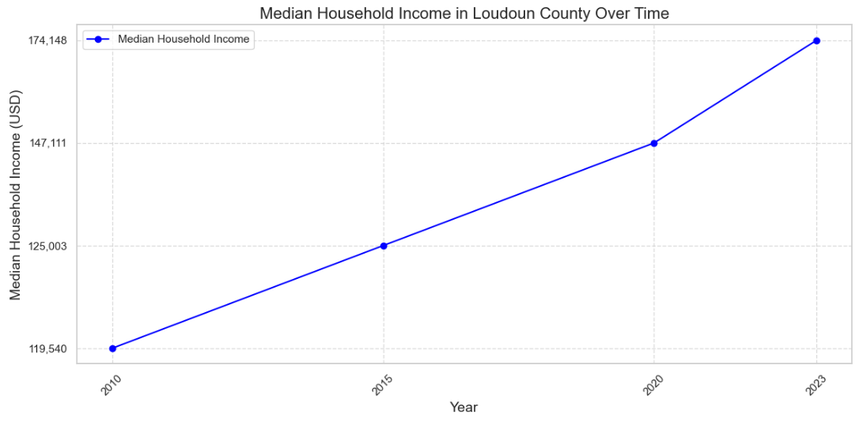
Median Household Income in Loudoun County (2010-2023)
Income Growth: Median income rose from $119,540 (2010) to $174,148 (2023).
Economic Strength: Growth reflects strong development and high living standards.
Affluence: Income levels are well above national averages, marking Loudoun as a prosperous region.

Slide 11
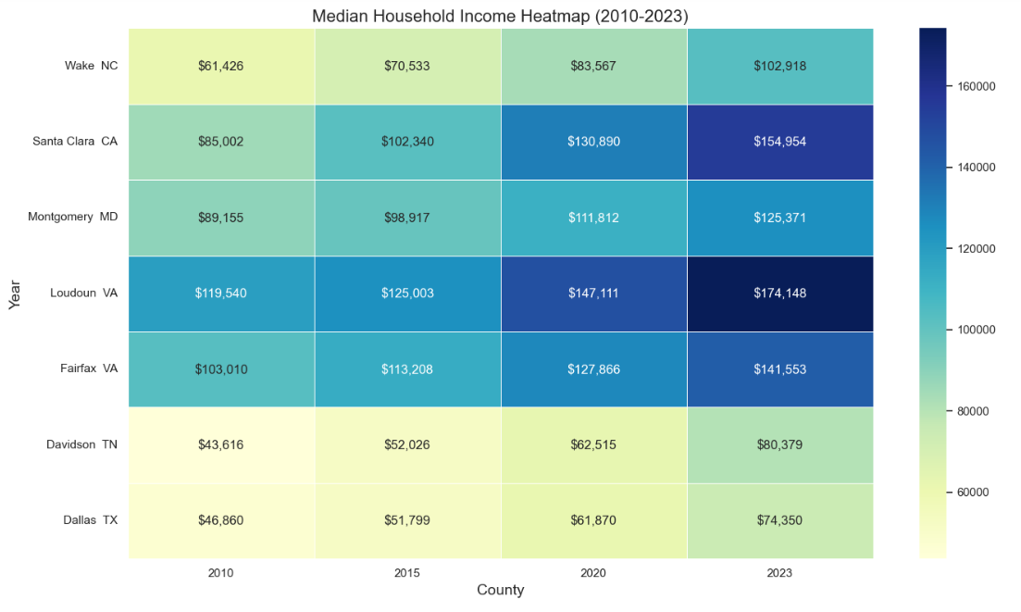
Median Household Income by County (2010-2023)
Loudoun County leads in median income growth, rising from $119,540 (2010) to $174,148 (2023), reflecting economic strength.
Santa Clara, CA, and Fairfax, VA, follow, showcasing competitive standards in tech and government hubs.
Davidson, TN, and Dallas, TX, show growth but trail Loudoun, reflecting diverse economic bases

Slide 12
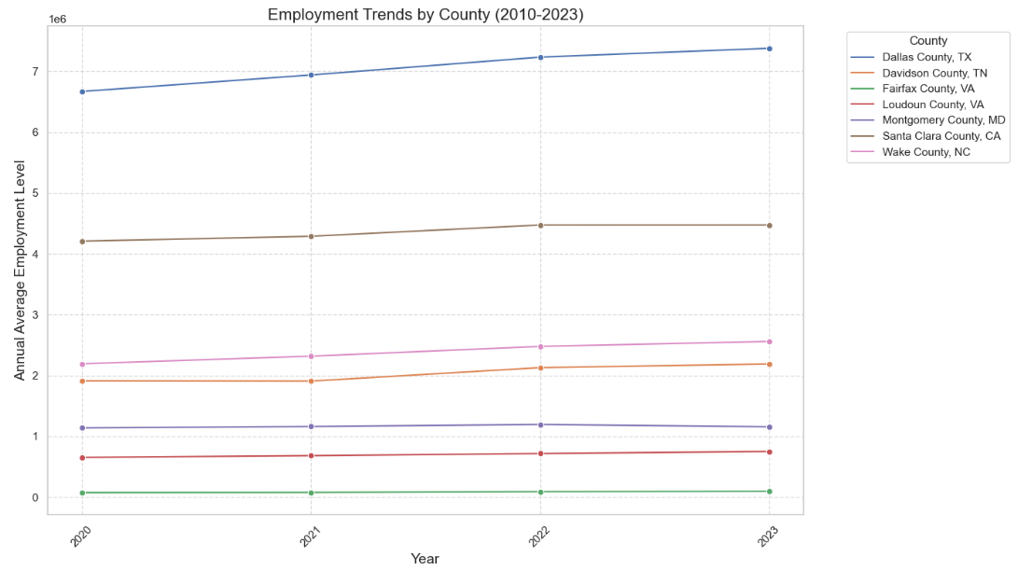
Employment Trends by County (2010-2023)
Dallas County, TX leads in employment levels, driven by its metropolitan workforce and diverse economy.
Loudoun County, VA shows steady growth, led by tech and service industries, though behind Dallas and Santa Clara.
Employment trends reflect consistent growth, emphasizing economic resilience and diversification.

Slide 13
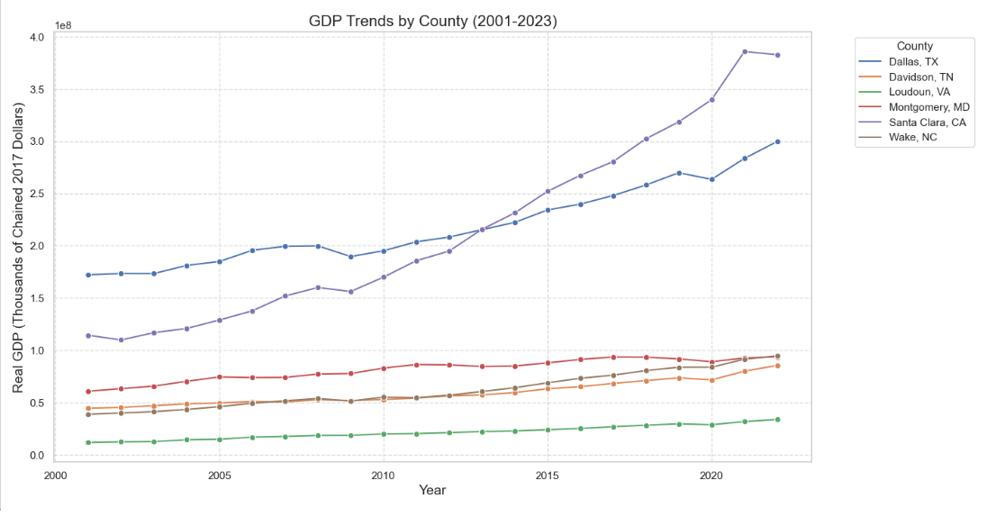
GDP Trends by County (2001-2023)
Santa Clara County, CA leads in GDP growth, driven by Silicon Valley's tech economy.
Dallas County, TX shows consistent increases, highlighting its diverse and resilient economy.
Loudoun County, VA exhibits steady growth, marking its rise as a tech and services hub.

Slide 14
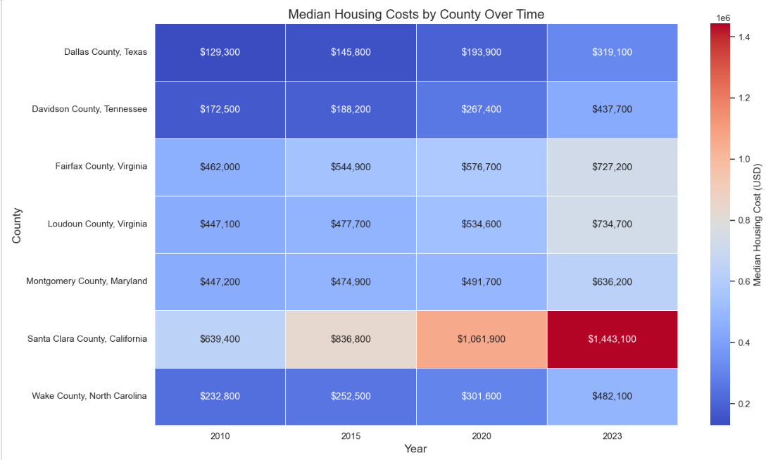
Median Housing Costs by County (2010-2023)
Santa Clara County, CA, tops housing costs, climbing from $639,400 in 2010 to $1,443,100 in 2023, driven by the tech industry and high demand.
Loudoun County, VA, saw a steady rise, reaching $734,700 in 2023, reflecting its growing affluence and appeal.
Davidson County, TN, and Dallas County, TX, showed moderate growth, maintaining affordable housing compared to higher-cost areas.

Slide 15
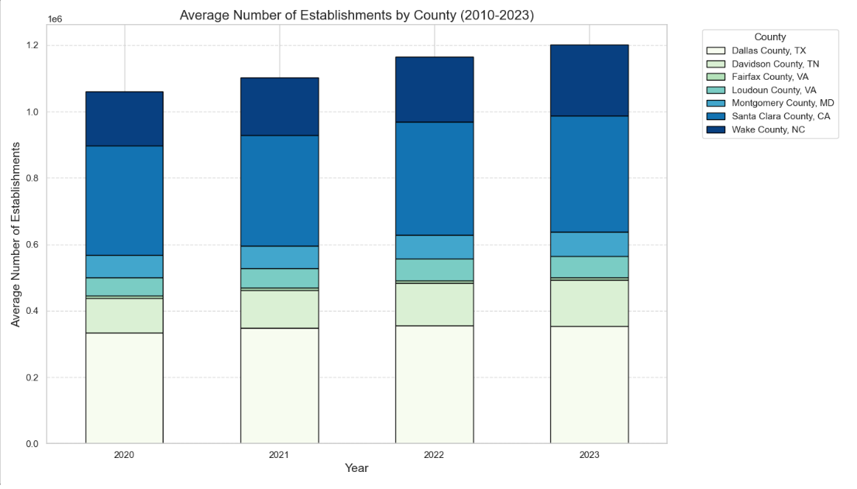
Average Number of Establishments by County (2010-2023)
Dallas County, TX, consistently leads in the average number of establishments, reflecting its diverse economy and large population.
Santa Clara County, CA, and Montgomery County, MD, highlight high business density, driven by tech and professional services.
Loudoun County, VA, exhibits steady growth, emphasizing its rising economic significance in the region.

Slide 16
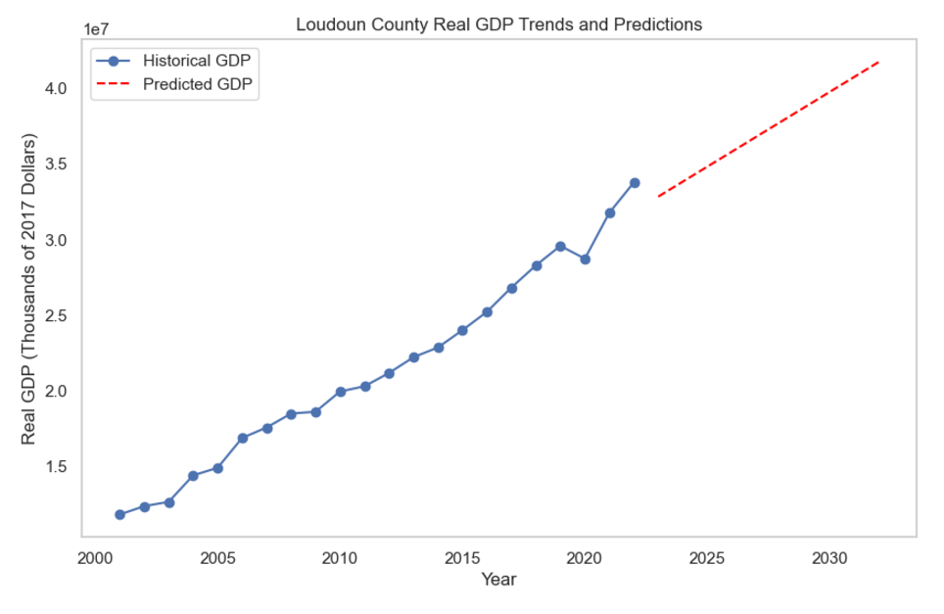
Loudoun County Real GDP Trends and Predictions
Historical GDP of Loudoun County has shown steady growth, reflecting its economic expansion.
Linear regression projections indicate continued GDP growth through 2030.
Projected trends highlight strong economic foundations and growth potential for the county.

Slide 17
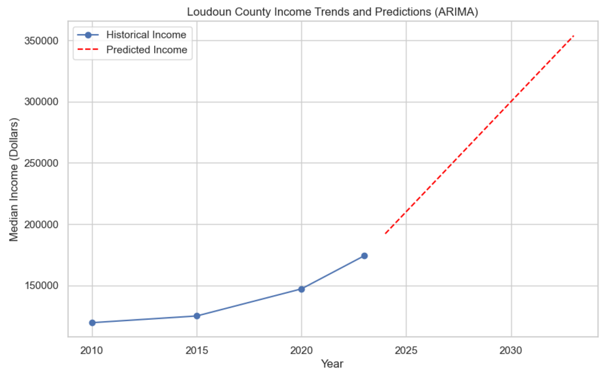
Loudoun County Income Trends and Predictions
Median income in Loudoun County has shown steady growth over the last decade.
ARIMA projections indicate a continued upward trend through 2030.
Predicted median income may exceed $350,000 by 2030, reflecting strong economic growth.

Slide 18
Recommendations
Support Sustainable Growth: Incentivize businesses, especially in tech and professional services.
Address Housing Affordability: Develop policies to keep housing accessible and attract diverse talent.
Leverage Economic Growth: Invest in infrastructure, education, and community development projects.
Enhance Data-Driven Policies: Monitor trends to guide future decisions.
Workforce Development: Align training programs with emerging industry demands.

Slide 19
Limitations
Data Gaps: Missing or inconsistent data for certain years.
Assumptions: Forecasting models are based on historical data trends.
Granularity: Industry-specific insights may require additional detailed datasets.

Slide 20
Conclusion
Economic Growth: Loudoun County shows consistent GDP, income, and housing growth, solidifying its role as a thriving hub.
Dynamic Employment: Strong employment trends and industry expansion highlight economic resilience.
Future Potential: Growth projections offer opportunities for housing, workforce, and business planning.
Key Insight: Despite challenges, Loudoun’s economic foundation ensures a strong outlook for success.

Slide 21
Questions
Any questions?
Feel free to ask for clarifications or further insights on the analysis.
Thank you for your attention! I appreciate your time and interest in this study.

